Slide 1
Promotions
Promotions is the transfer of an employee to a job which pays more money or one that carries some preferred status.
Upward movement from current status to higher status in the organization.
PIGOURS AND MYERS,” Promotion is advvancement of an employee to a better job- better in terms of greater responsibility more presitige or statis greater skill and especially increased rate of pay or salary.”

Slide 2
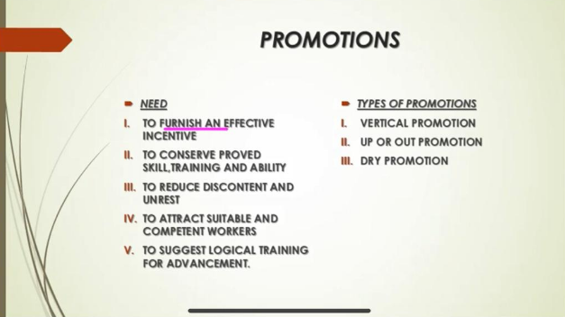

Slide 3
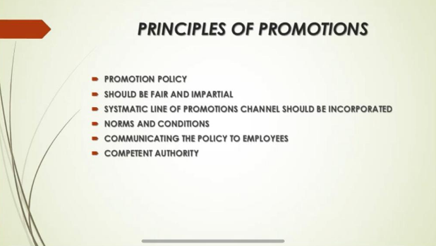

Slide 4
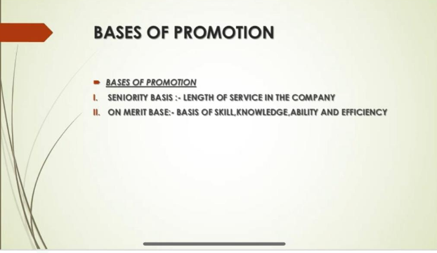

Slide 5
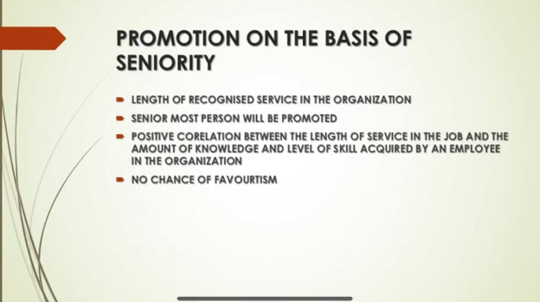

Slide 6
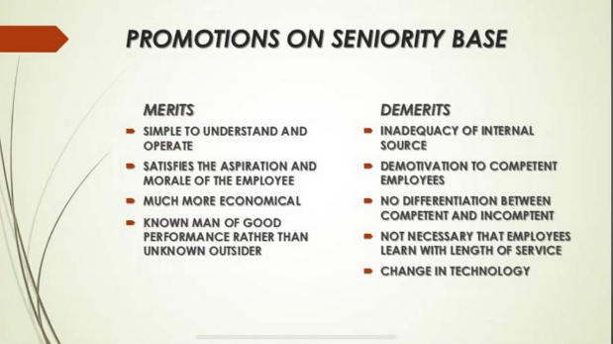

Slide 7
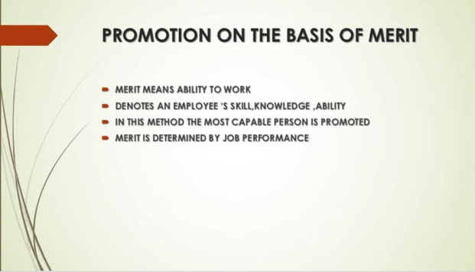

Slide 8
